Slide 1
CS 3186
Elementary Questions About Regular Languages
Section 4.2

Slide 2
Standard Representations of Regular Languages
Regular Languages
DFAs
Regular
Grammars
NFAs
Regular
Expressions

Slide 3

When we say:
We are given
a Regular Language
We mean:
Language is in a standard
representation
Elementary Questions about regular languages
Describe a procedure to answer the question

Slide 4


Membership Question
Question:
Given regular language
and string
how can we check if ?
Answer:
Take the DFA that accepts
and check if is accepted

Slide 5


DFA
DFA

Slide 6
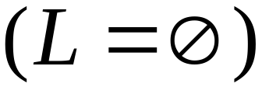
Question:
Given regular language
how can we check
if is empty: ?
Answer:
Take the DFA that accepts
Check if there is any path from
the initial state to a final state

Slide 7


DFA
DFA

Slide 8
Question:
Given regular language
how can we check
if is finite?
Answer:
Take the DFA that accepts
Check if there is a walk with cycle (loop) from the initial state to a final state

Slide 9
DFA
is infinite
DFA
is finite

Slide 10


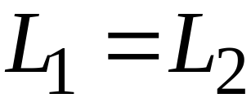

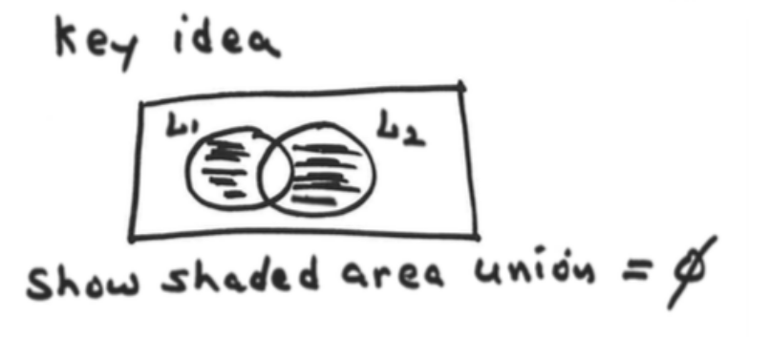

Question:
Given regular languages and
how can we check if ?
Answer:
Find if
Procedure:
1. Construct DFAs for L₁, L₂
2. Construct DFA for
3. Check if the language accepted by the above DFA is empty. i.e., if there is path from initial state to final state

Slide 11
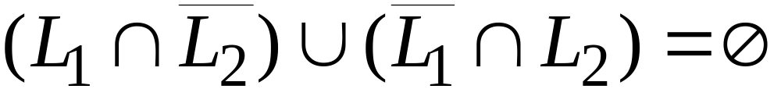
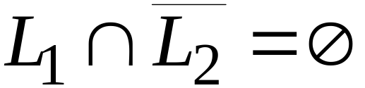
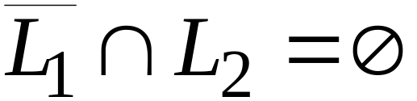


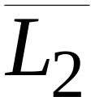
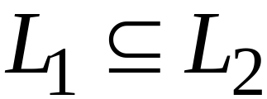
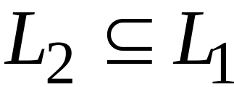
i.e, both and

Slide 12
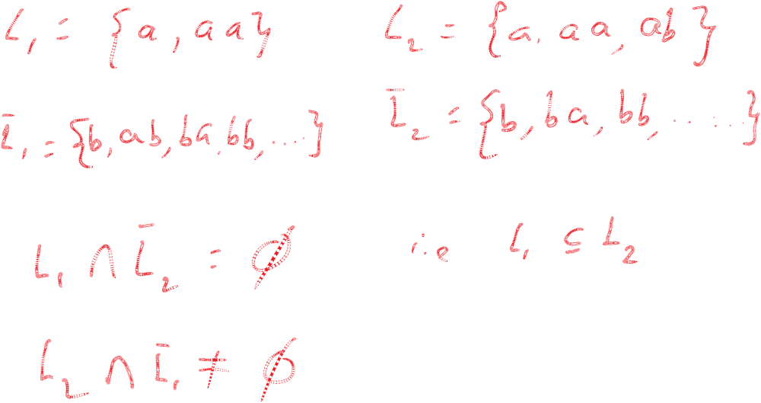

Slide 13
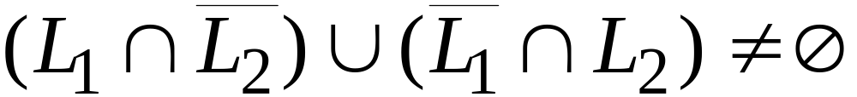
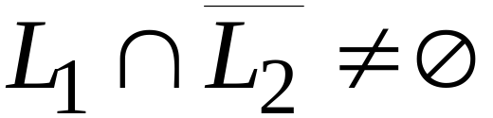
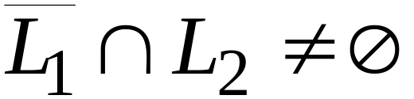
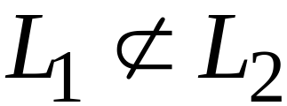
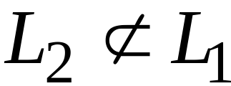
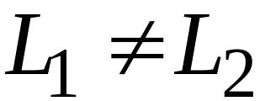
i.e, either or

Slide 14


Question:
Given regular language L, how can we determine if there is a string w, such that w and w^{R}
Ex: L ={ab, aab, aab, ba}. w = ab and w^{R}
i.e., Does L have atleast one palindromic string in L
Answer: Procedure
Construct dfa, M, for L
Construct dfa, M₁ for L^{R}
Construct dfa for L L^{R}
Check if the language accepted by the above dfa is not empty.
If the language is not empty, there is at least one string w and w^{R}

Slide 15
(I) Do exercises #1 to #8
Homework 4.2

